Slide 1
DOM Document Object Model
Stettsen Olsen

Slide 2
DOM, What is that?
Good question. You tell me.

Slide 3
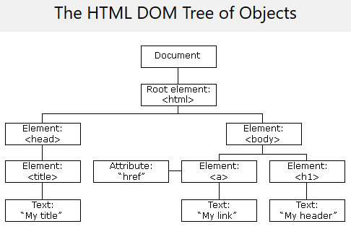
DOM, What is that?
Document Object Model allows you to reference the document as an object variable.
This is how JavaScript or other languages would be able to dynamically change the document.

Slide 4
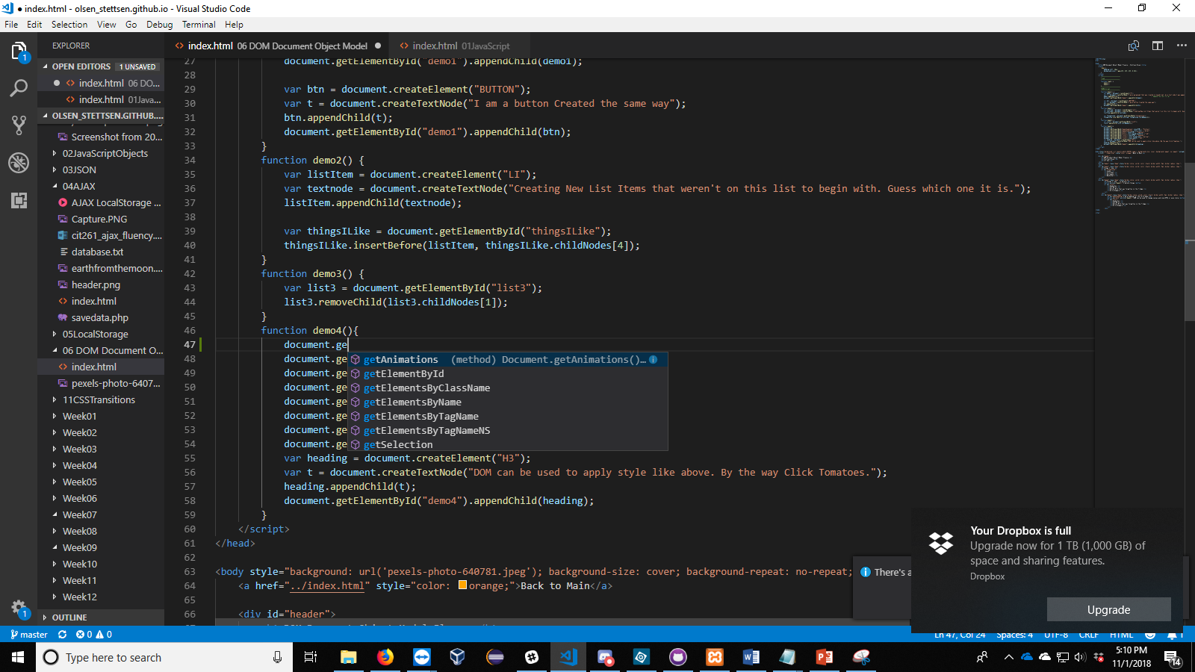
The Object
The document object is called and then it’s function.
Functions such as ->
can be used to return an array
of elements or a single element.

Slide 5
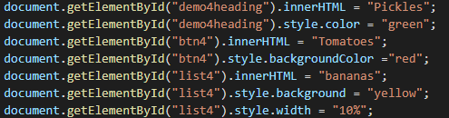
Attributes
Attributes are all the little CSS properties or HTML properties that can be modified.
The name convention is kept very similar to CSS, but they do have some differences.

Slide 6
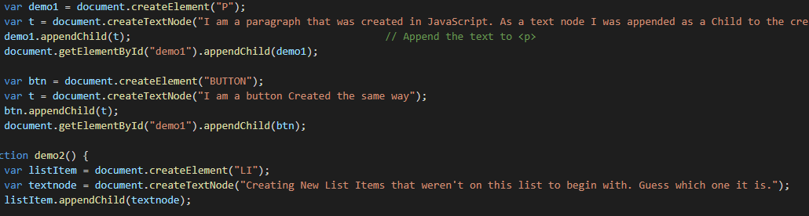
createElement and appendChild

Slide 7
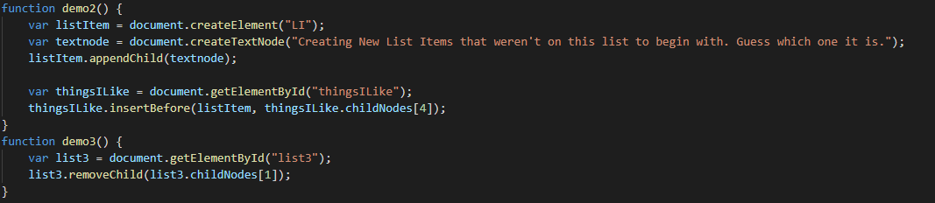
insertBefore and removeChild

